Slide 1
Creative Economy: Partners with the BIA
Karen.Dubeau@barrie.ca
march 2019

Slide 2
What is Creative Economy?
Culture + Innovation = Community and Experience
Entrepreneurship + Arts = Capacity Building and Ecosystem
Knowledge-based Sectors -> Catalyst
Strategic Infrastructure for the Future
GROWING RESILIENT, DIVERSE ECONOMY

Slide 3
How?
Capacity Development Sprout, Artrepreneur, Music Incubator Grant writing workshops Innovation Supports, Digital Main Street Cultural Grants
Community Building Festivals, Events – by design Early adoption/civic engagement Talent Attraction & Development Tourism
Strategic Infrastructure Meridian, Sandbox, Fisher, Smart Cities Harnessing municipal assets to showcase Thought Leadership
COLLABORATION IS THE KEY – IDEA GENERATION IS THE POWER
Notes:
Grow capacity building programs – Artrepreneur, Sprout, Music Incubator, in targeted sectors
Support development of capacity for data sharing across ecosystem players – holistic reporting, measurement
Support growth/expansion of One Degree Network platform, StartUp Barrie Chapter
Ensure municipal infrastructure/assets can be leveraged to showcase Barrie entrepreneurs (Theatre concession, pop up retail)
Continue growth of Barrie knowledge-based business sector (gaming, software development, data analytics, AI, digital media)
Municipality as early adopter/co-designer with startup companies – Municipal Innovation Exchange (MIX), research projects

Slide 4
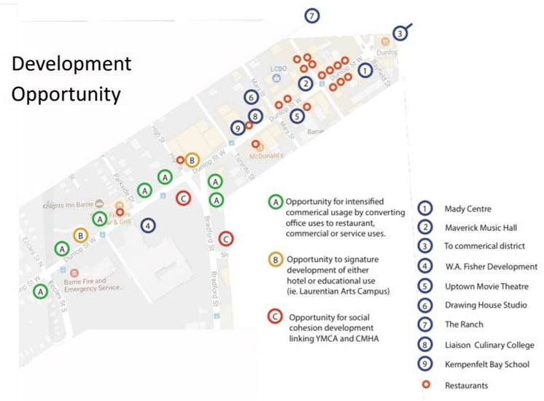
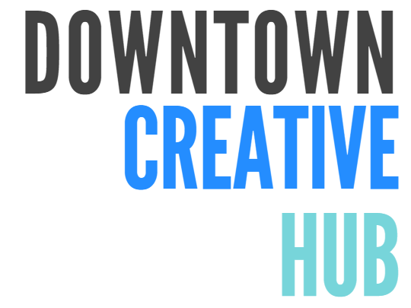

Slide 5
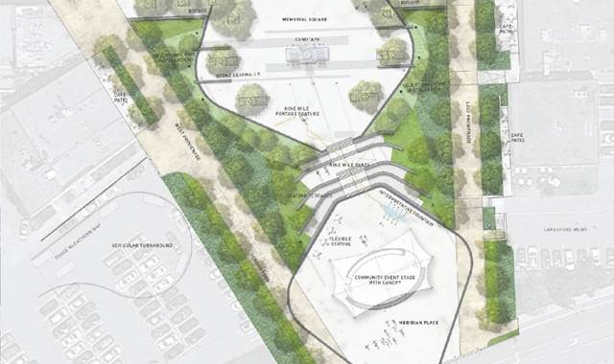
Downtown Creative Corridor: Infrastructure
Current Initiatives:
Increased utilization at Five Points → 179 programmed days (from 140)
Sandbox Entrepreneurship Centre → Opening April 8th
Meridian Square → 2018: 47 events, 43,935 attendees
→ Public Art, Capital Program, MWG
Dunlop street-scaping → September start
Longer Term Initiatives
Community makerspace
Permanent Market
Fisher Auditorium and Conference Centre

Slide 6
Downtown Creative Corridor: Programs
Sandbox Entrepreneurship Center
Startups, Main street, existing businesses
Co-location: SBEC, HBEC and other ecosystem partner organizations: one place
Peer groups, workshops, training, connections
Youth Arts Drop Ins – Monthly
Incubator Programs
Music Incubator
Sprout for food entrepreneurs
Artrepreneur
Pop up Markets for Entrepreneurs and Makers
Emerging Musicians – street performers program
Innovation Programs – harnessing innovators to solve challenges; hackathons

Slide 7
Events: Permitting & Curating
Permitting Function: 174 on waterfront and Meridian – (vs 110 in 2017)
Streamlining permit process
At capacity on waterfront
Identifying strategic economic focus areas to:
Fill gaps in programming (i.e. wine and food festival)
Build brand/attract audiences (TD Irie festival)
Support tourism, talent attraction efforts (GTA, international)
Support development of targeted sectors/clusters
Need to balance commercial, ticketed events with open, community access events

Slide 8
Events – Development
Objectives:
Continue to work with community partners to expand unique Barrie assets (Film Festival, Game On, Kempenfest, Xcelerate)
Building capacity of those partner organizations – inclusion of technology, best practices for multi-venue events
Continue to build events programming re: Barrie entrepreneurship, job opportunities, strategic campaigns
Leverage entrepreneurship supports for business model development
Ties to Tourism Master Plan

Slide 9
Downtown Events – Strategic
Large events – Canada Day, Celebrate Barrie, Winterfest, Downtown Countdown
As community celebrations
As tourism draw
As strategic engagement / messaging
2019: Snowbirds! Aviation related activations
Events supporting Cluster Development
Game On – 400+ attendees in year 2
Industry 4.0 Mapping – 80+ companies
Manufacturing Innovation Summit – 120+ attendees
Xcelerate Summit – largest attendance ever in 2018

Slide 10
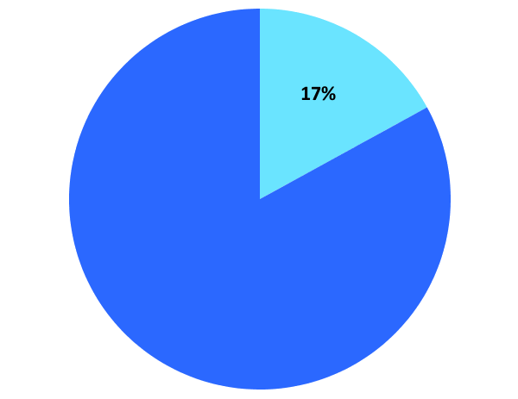
180,000 people attended
Invest-Barrie
run events
179 Days of use at Five Points Theatre in 2018
17% of attendees were out of town visitors

Slide 11
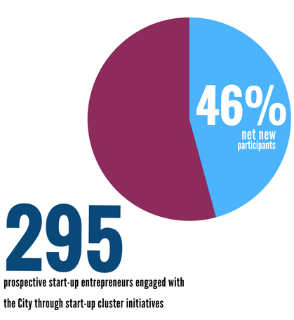
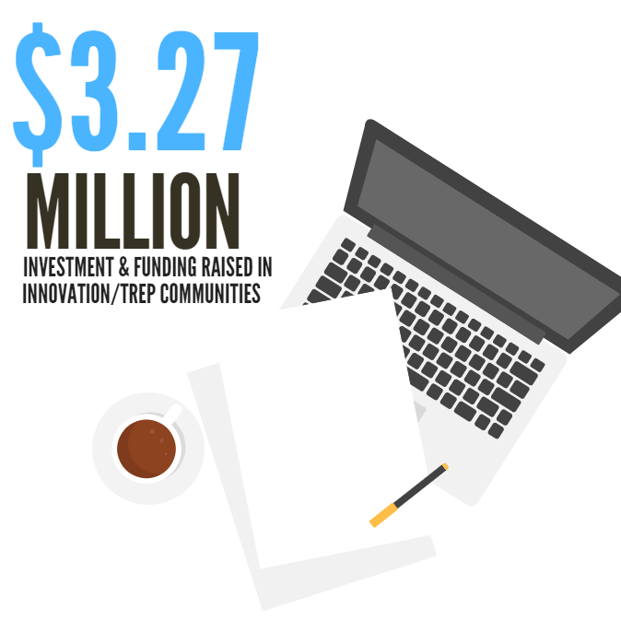
Start-up Ecosystem Initiatives
Notes:
most of the funding is being spent within the community

Slide 12
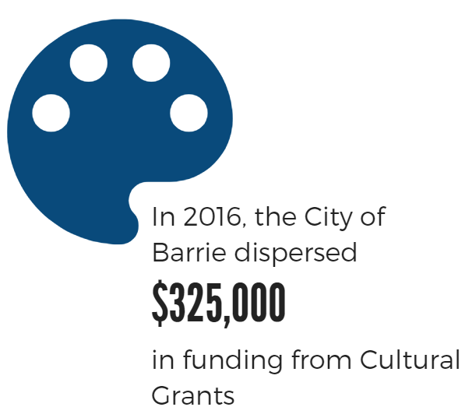
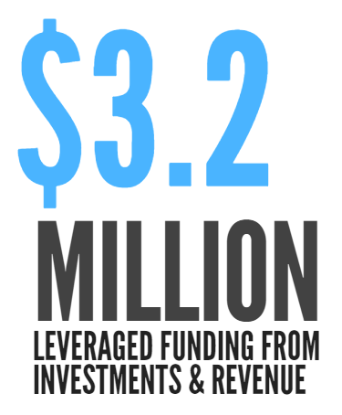
Impact: Cultural Investments

Slide 14
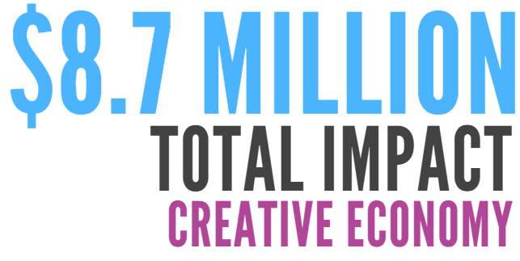
Innovation and Entrepreneurship: $ 3,227,000
Funds raised through Permitted Events: $ 2,260,000
Funding and Revenue – Cultural Grantees $ 3,220,203
Total Economic Impact in 2017: $ 8,707,203

Slide 15
Social media channels
for targeted messaging
@CreativeBarrie
Karen.Dubeau@barrie.ca

